Slide 1

Dark Elegant
Korean Style Project Proposal
Here is where your presentation begins

Slide 2

Contents of this template
Here’s what you’ll find in this Slidesgo template:
A slide structure based on a project proposal, which you can easily adapt to your needs. For more info on how to edit the template, please visit Slidesgo School or read our FAQs.
An assortment of graphic resources that are suitable for use in the presentation can be found in the alternative resources slide.
A thanks slide, which you must keep so that proper credits for our design are given.
In the resources slide, where you’ll find links to all the elements used in the template.
Instructions for use.
Final slides with:
The fonts and colors used in the template.
A selection of illustrations. You can also customize and animate them as you wish with the online editor. Visit Storyset to find more.
More infographic resources, whose size and color can be edited.
Sets of customizable icons of the following themes: general, business, avatar, creative process, education, help & support, medical, nature, performing arts, SEO & marketing, and teamwork.
You can delete this slide when you’re done editing the presentation.

Slide 3
Whoa!
This can be the part of the presentation where you can introduce yourself

Slide 4

Table of contents
01
02
03
04
05
06
About the project
Requirements
Project goals
You can describe the topic of the section here
You can describe the topic of the section here
You can describe the topic of the section here
Sneak peek
Project stages
Our team
You can describe the topic of the section here
You can describe the topic of the section here
You can describe the topic of the section here

Slide 5
Introduction
Do you know what helps you make your point clear? Lists like this one:
They’re simple
You can organize your ideas clearly
You’ll never forget to buy milk!
And the most important thing: the audience won’t miss the point of your presentation

Slide 6

01
About the project
You can enter a subtitle here if you need it

Slide 7

Our company
Mercury is the smallest planet in the Solar System and the closest to the Sun. Its orbit around the Sun takes 87.97 Earth days, the shortest of all

Slide 8

What are we working on?
Retail
Residential
Hospitality
Neptune is the farthest planet from the Sun and the fourth-largest
Mercury is the closest planet to the Sun and the smallest of them all
Saturn is a gas giant with a radius of about nine times that on Earth

Slide 9

About the project
Fifth in line from the Sun, Jupiter is, by far, the largest planet in the Solar System—more than twice as massive as all the other planets combined

Slide 10

—Someone famous
“This is a quote, words full of wisdom that someone important said and can make the reader get inspired.”

Slide 11

Now
Saturn is unique among the planets. It is not the only planet to have rings—made of chunks of ice and rock—but none are as spectacular or as complicated as Saturn's

Slide 12

Future
Venus is the second planet from the Sun and is Earth’s closest planetary neighbor. It’s one of the four inner, terrestrial (or rocky) planets, and it’s often called Earth’s twin

Slide 13
Major requirements
Neptune
Venus
It’s the eighth and farthest-known solar planet from the Sun
Venus has a beautiful name, but also very high temperatures
Mercury
Saturn
Mercury is the closest planet to the Sun and the smallest of them all
Saturn is a gas giant with a radius of about nine times that on Earth

Slide 14

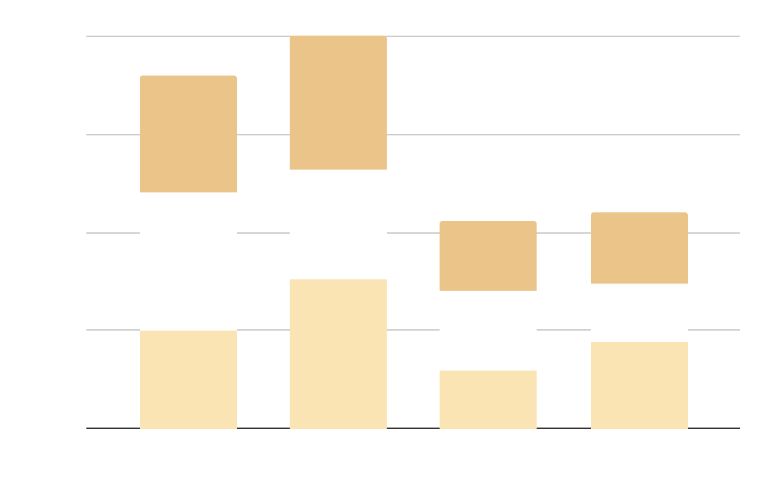
Budget
September
It’s the fifth planet from the Sun and the largest
October
It’s the eighth and farthest known solar planet
November
Saturn is a gas giant with a radius of about nine times
Follow the link in the graph to modify its data and then paste the new one here. For more info, click here

Slide 15

A picture always reinforces the concept
Images reveal large amounts of data, so
remember: use an image instead of a long text. Your audience will appreciate it

Slide 16
Niche market
Target 1
It’s the fifth planet from the Sun and the largest
Target 2
It’s the eighth and farthest known solar planet

Slide 17

325,458,700
Big numbers catch your audience’s attention

Slide 18

Project goals
Neptune
Venus
Saturn
It’s the eighth and farthest-known solar planet from the Sun
Venus has a beautiful name, but also very high temperatures
Saturn is a gas giant with a radius of about nine times that on Earth
Jupiter
Mercury
Mars
It’s the fifth planet from the Sun and the largest in the Solar System
Mercury is the closest planet to the Sun and the smallest of them all
It’s the fourth planet from the Sun and it’s a cold place

Slide 19
Awesome words

Slide 20
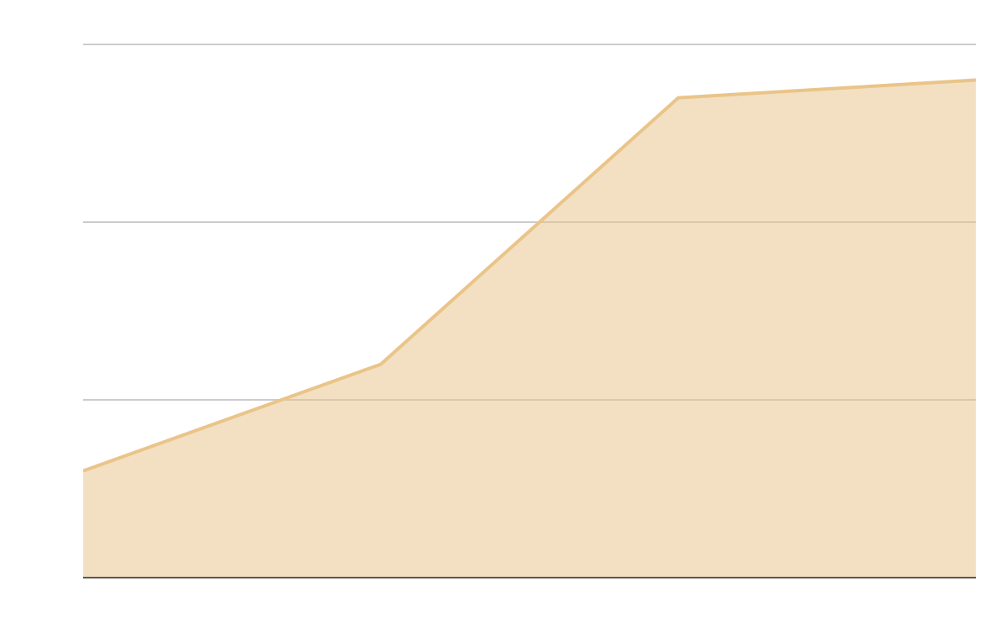
Predicted results
$35,000
Expected income for 2022
10,000
Potential buyers next year
Follow the link in the graph to modify its data and then paste the new one here. For more info, click here

Slide 21
04
Sneak peek
You can enter a subtitle here if you need it

Slide 22

Sneak peek
You can replace the image on the screen with your own work. Just right-click on it and select “Replace image”

Slide 23
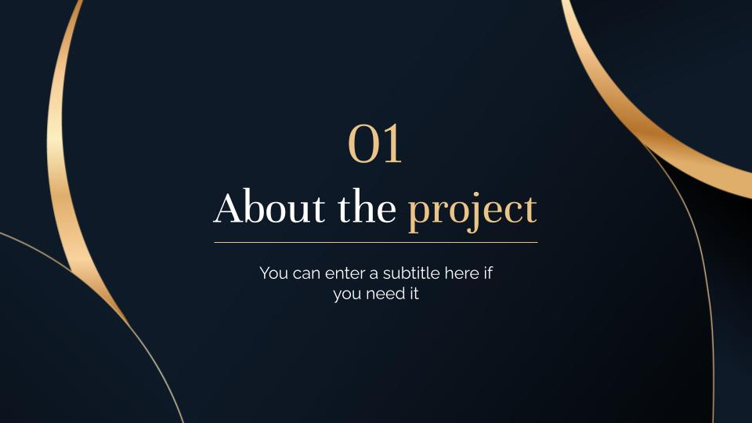
Sneak peek
You can replace the image on the screen with your own work. Just right-click on it and select “Replace image”

Slide 24

A picture is worth a thousand words

Slide 25
Project stages
 |  | Phase 1 | Phase 2
 | Stage 1 | Jupiter is the biggest planet | It’s a gas giant and has several rings
 | Stage 2 | Neptune is very far away from us | Despite being red, Mars is a cold place
 | Stage 3 | Mercury is the smallest planet | Venus has a beautiful name

Slide 26

333,000.000
1,111,100 m
Jupiter is the biggest planet of them all
Earth is the planet where we live on

Slide 27
Project timeline 2022
Ideation
Execution
Implementation
01
02
03
Jan
Feb
Mar
Apr
May
Jun
Jul
Aug
Sep
Oct
Nov
Dec

Slide 28

Our partners
Jupiter
Mercury
It’s the fifth planet from the Sun and the largest in the Solar System
Mercury is the closest planet to the Sun and the smallest of them all

Slide 29
SWOT analysis
Strengths
Threats
It’s the eighth and farthest-known solar planet from the Sun
Saturn is a gas giant with a radius of about nine times that on Earth
S
T
W
O
Weaknesses
Opportunities
It’s the fifth planet from the Sun and the largest in the Solar System
It’s the fourth planet from the Sun and it’s a cold place

Slide 30




Our team
Sophia Hill
Timmy Jimmy
Sarah Brown
You can talk a bit about this person here
You can talk a bit about this person here
You can talk a bit about this person here

Slide 31

Thanks!
Do you have any questions?
your-email@freepik.com
+91 620 421 838 | yourcompany.com
Please keep this slide for attribution

Slide 32
Icon pack: startups | filled

Slide 33
Alternative resources
Here’s an assortment of alternative resources whose style fits that of this template:
Vectors:
Infographic template with linear map
First communion blue elements
Photos:
Man holding the bible on the table
Side view of woman praying with bible
Front view of woman praying with bible
Priest holding holy cross on hands
Woman reading the bible indoors I
Woman reading the bible indoors II
Top view hands holding holy necklace
Woman praying for her loved ones

Slide 34
Resources
Did you like the resources on this template? Get them for free at our other websites:
Vectors:
Gradient golden luxury business cards template
Linear hungary map infographic
Photos:
Young woman using laptop and notebook with pen for notes
Side view colleagues working together
Front view of business man and woman
High angle corporate meeting mock-up
Beautiful asian woman portrait
Photos:
Young japanese man portrait with glasses
Close up beautiful smiley woman
Icons:
Icon Pack: Startups | Filled

Slide 35
Instructions for use
In order to use this template, you must credit Slidesgo by keeping the Thanks slide.
You are allowed to:
- Modify this template.
- Use it for both personal and commercial projects.
You are not allowed to:
- Sublicense, sell or rent any of Slidesgo Content (or a modified version of Slidesgo Content).
- Distribute Slidesgo Content unless it has been expressly authorized by Slidesgo.
- Include Slidesgo Content in an online or offline database or file.
- Offer Slidesgo templates (or modified versions of Slidesgo templates) for download.
- Acquire the copyright of Slidesgo Content.
For more information about editing slides, please read our FAQs or visit Slidesgo School:
https://slidesgo.com/faqs and https://slidesgo.com/slidesgo-school

Slide 36
Instructions for use (premium users)
As a Premium user, you can use this template without attributing Slidesgo or keeping the "Thanks" slide.
You are allowed to:
Modify this template.
Use it for both personal and commercial purposes.
Hide or delete the “Thanks” slide and the mention to Slidesgo in the credits.
Share this template in an editable format with people who are not part of your team.
You are not allowed to:
Sublicense, sell or rent this Slidesgo Template (or a modified version of this Slidesgo Template).
Distribute this Slidesgo Template (or a modified version of this Slidesgo Template) or include it in a database or in any other product or service that offers downloadable images, icons or presentations that may be subject to distribution or resale.
Use any of the elements that are part of this Slidesgo Template in an isolated and separated way from this Template.
Register any of the elements that are part of this template as a trademark or logo, or register it as a work in an intellectual property registry or similar.
For more information about editing slides, please read our FAQs or visit Slidesgo School:
https://slidesgo.com/faqs and https://slidesgo.com/slidesgo-school

Slide 37
Fonts & colors used
This presentation has been made using the following fonts:
Unna
(https://fonts.google.com/specimen/Unna)
Raleway
(https://fonts.google.com/specimen/Raleway)
#0c1621
#eac488
#fbe4b4
#ffffff

Slide 38
Storyset
Create your Story with our illustrated concepts. Choose the style you like the most, edit its colors, pick the background and layers you want to show and bring them to life with the animator panel! It will boost your presentation. Check out How it Works.
Pana
Amico
Bro
Rafiki
Cuate

Slide 39
Use our editable graphic resources...
You can easily resize these resources without losing quality. To change the color, just ungroup the resource and click on the object you want to change. Then, click on the paint bucket and select the color you want. Group the resource again when you’re done. You can also look for more infographics on Slidesgo.

Slide 42
JANUARY
FEBRUARY
MARCH
APRIL
MAY
JUNE
PHASE 1
Task 1
Task 2
PHASE 2
Task 1
Task 2
JANUARY
FEBRUARY
MARCH
APRIL
PHASE 1
Task 1
Task 2

Slide 45
...and our sets of editable icons
You can resize these icons without losing quality.
You can change the stroke and fill color; just select the icon and click on the paint bucket/pen.
In Google Slides, you can also use Flaticon’s extension, allowing you to customize and add even more icons.

Slide 46
Educational Icons
Medical Icons

Slide 47
Business Icons
Teamwork Icons

Slide 48
Help & Support Icons
Avatar Icons

Slide 49
Creative Process Icons
Performing Arts Icons

Slide 50
Nature Icons

Slide 51
SEO & Marketing Icons

Slide 52


